Slide 1
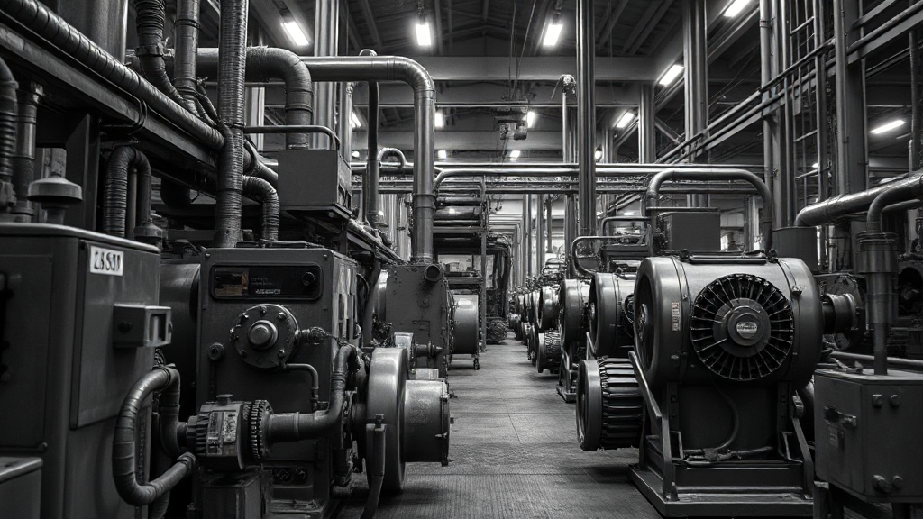


Statement of Qualifications

Slide 2
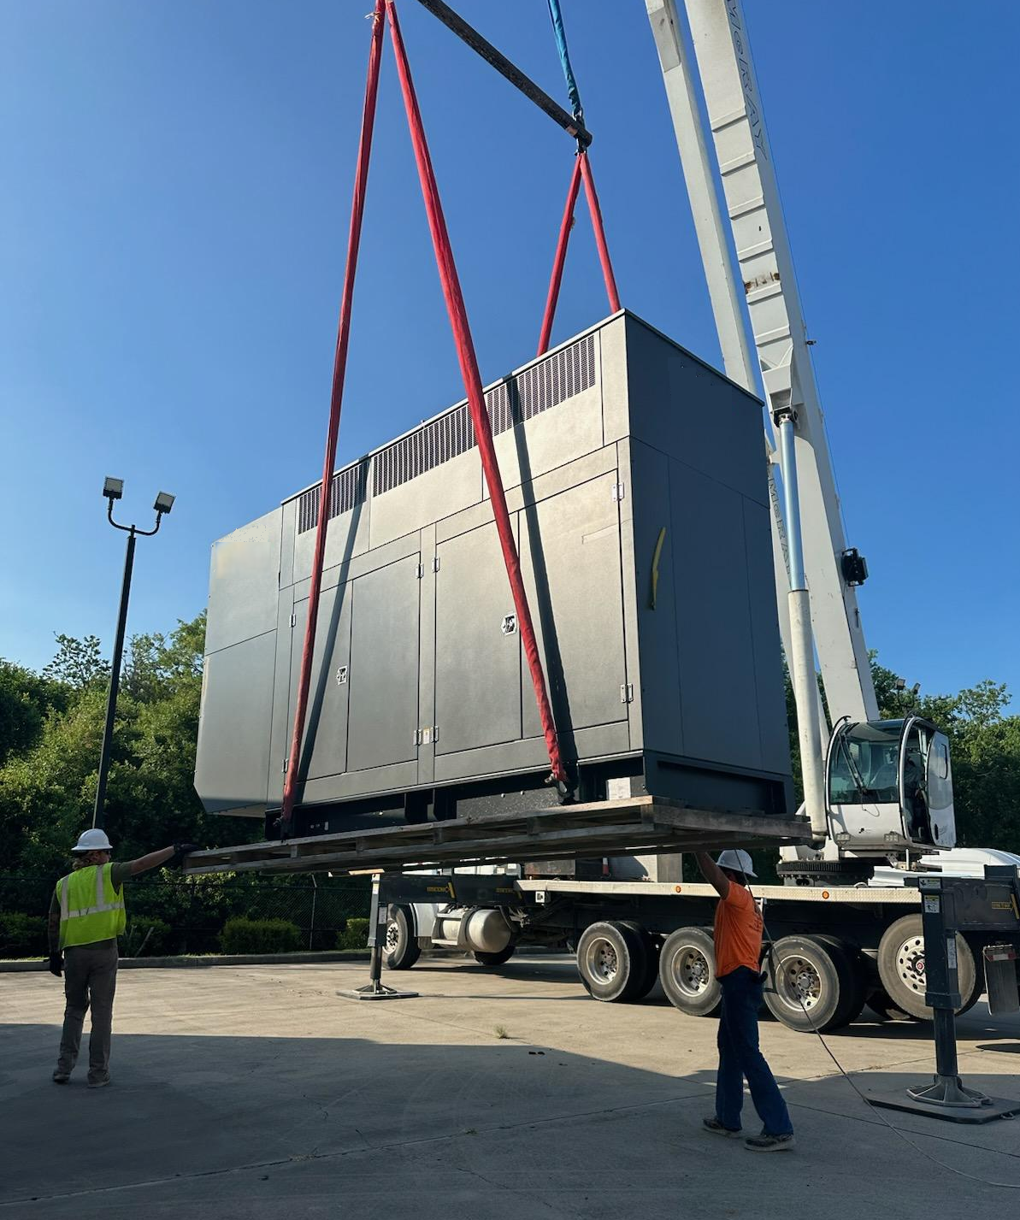
About Exergy
Exergy Energy was formed to develop, own, and operate power generation and storage facilities in an increasing complex market for energy. Our solutions remove the burdens for our customers of overseeing construction, operations, and maintenance of energy facilities.
The increase in intermittent renewables on the grid, coupled with the rise of extreme weather, has resulted in a less reliable grid and a significant decline in power quality. Most companies lack the experience and domain knowledge to manage their energy demand in this complex and changing energy market.
Our model is simple: Exergy provides all of the capital and expertise. We select the equipment, and we own, operate and maintain the equipment for the benefit of our customers.
Exergy Supplies the Power Required to be Successful.

Slide 3
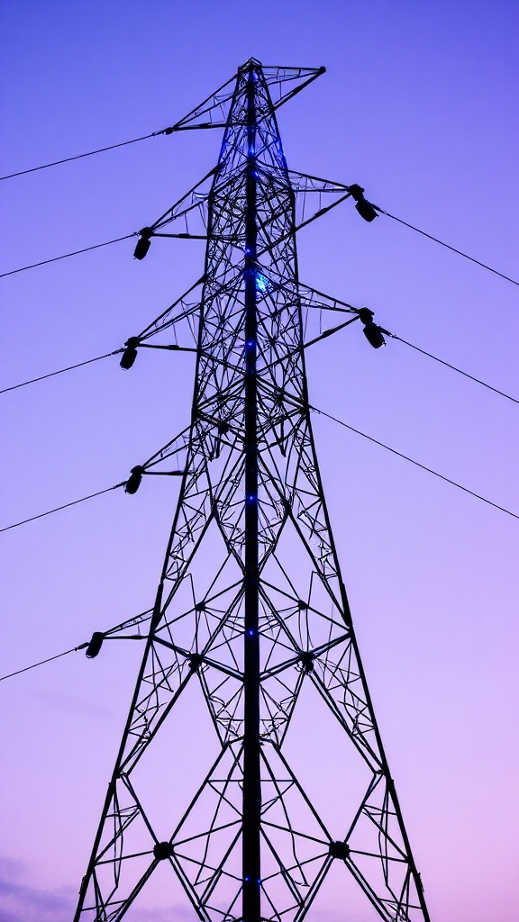
Energy Procurement ~ Electricity & Natural Gas
Facility Electrification Upgrades
Continuous (Prime) Power
Uninterruptable Power Supplies (“UPS”)
Backup Generators ~ Diesel and Natural Gas
Backup Batteries
Carbon Footprint Measurement & Reporting
Combined Heat and Power (“CHP”)
Our Services

Slide 4

Statement of Qualifications
Energy Development, construction, finance and operations of:
Natural Gas & Diesel Power Plants
Combined Heat and Power Facilities
Batteries
Solar
Over 448 MW Deployed, Including:
Elanco US Inc. – Indianapolis, IN & Fort Dodge, IA
BMO Harris Center – Rockford, IL
SPJST Senior Living – Taylor, TX
Soft Gel Technologies – Los Angeles, CA
Del Papa Distributing – Victoria & Texas City, TX
Upper Crust Bakery – Glenn Dale, MD
Repligen Corp – Marlborough, MA
SelecTransportation – Houston, TX
Silverleaf Eldercare – Multiple Locations in Texas
DK LIPA LLC – Brookhaven, NY
Boys & Girls Club – San Leandro, CA
United Methodist Church – Moorestown, NJ
Community Schools – Bethany, CT
Representative Projects In Development
JBS Foods – Multiple Locations
Littelfuse Inc.
International Delights
Ronald McDonald House
Forefront Presbyterian
Glen Rose Medical
Developed multiple projects for:
Pyrolysis Conversion
Plastics Recycling
Anaerobic Digestion Power Plants

Slide 5
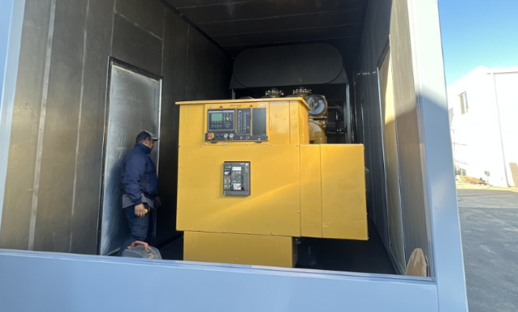
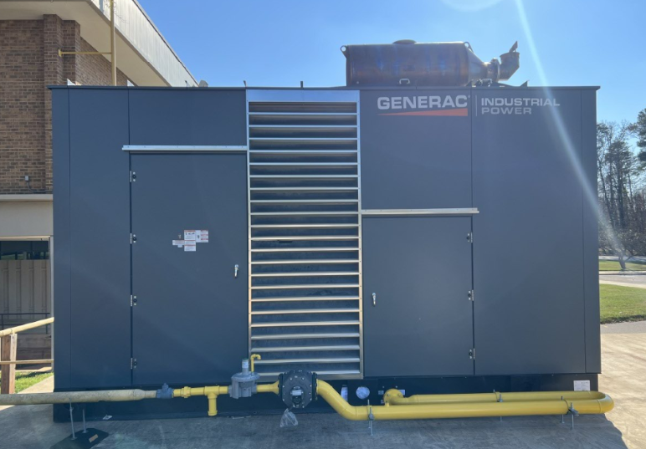
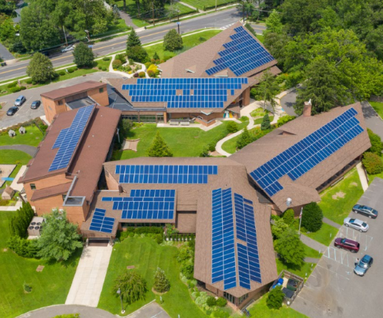
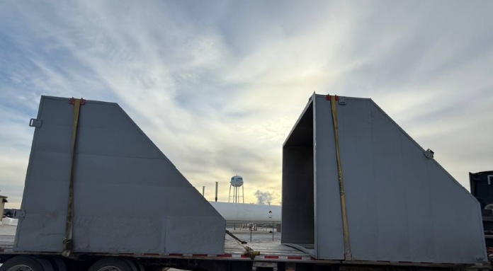









References
We serve a wide range of clients, customizing the right solutions for their unique needs.

Slide 6

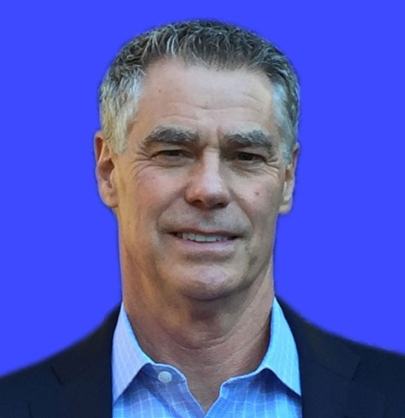
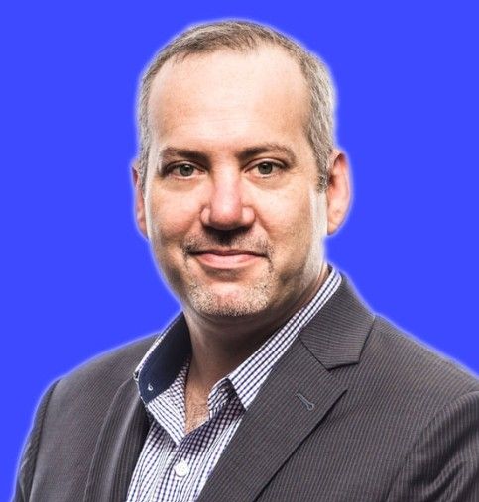
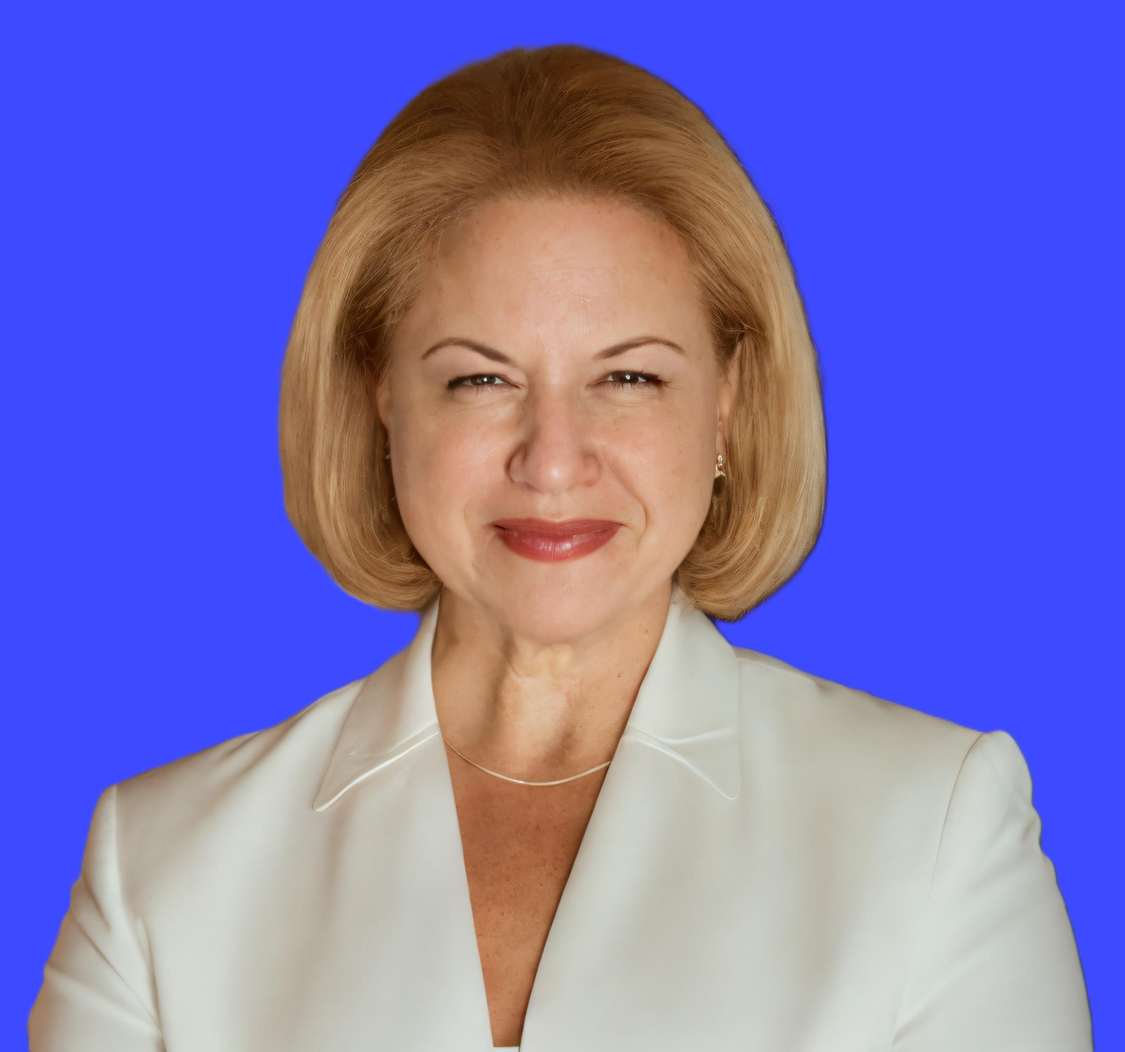
Exergy’s Management Team
David March
David Kurzman
Veronica Lombardi
As CEO, David oversees all strategic business development efforts at Exergy Energy.
He has been a serial entrepreneur in the energy and technology sectors having founded and run several high-technology instrumentation and software companies.
David earned a B.S. in Engineering Chemistry and an MBA in Quantitative Finance from Lehigh University.
He has also been awarded 2 patents in operational efficiency and optimization in complex process industries.
To date David has successfully completed 55 generation projects ranging from 1MW to 100 MW.
David leads finance and operations at the firm, serving as its Chief Financial Officer.
He has held several leadership roles as Portfolio Manager, Managing Partner of a CleanTech hedge fund, and he has held several research positions for private firms, investment banks, and a Registered Investment Company.
David earned his B.A. from Grinnell College, completed additional classes in accounting at Drake University, and holds an active Series 7/Registered Representatives license.
Veronica is Chief of Staff and Project Manager at Exergy Energy.
She has led project administration and client success teams in the energy industry for many years.
Prior to joining Exergy she managed operations for a solar development company, working with directors and staff of non-profit institutions across the country and completing over 100 systems currently in operation.
Veronica earned her B.A. from Pomona College and holds certifications in sales and service.

